Slide 1

Investing in Brazil

Slide 2





2005-2021 Main destinations of Chinese Investments
USD 187 bi
USD 101 bi
USD 96 bi
USD 61 bi
USD 61 bi
*China Global Investment Tracker

Slide 3

China and the Brazilian energy sector
Major share of Chinese investments in Brazil has happened in this sector
Most of State Grid and CTG foreign investments have happened in Brazil
China is responsible for producing 10% of the electricity in Brazil (98% of the Chinese companies in this sector are SOEs)

Slide 4
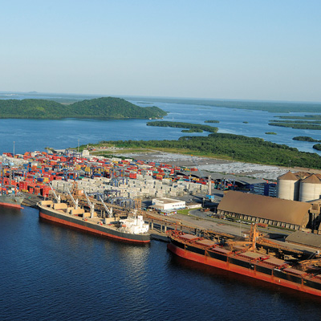
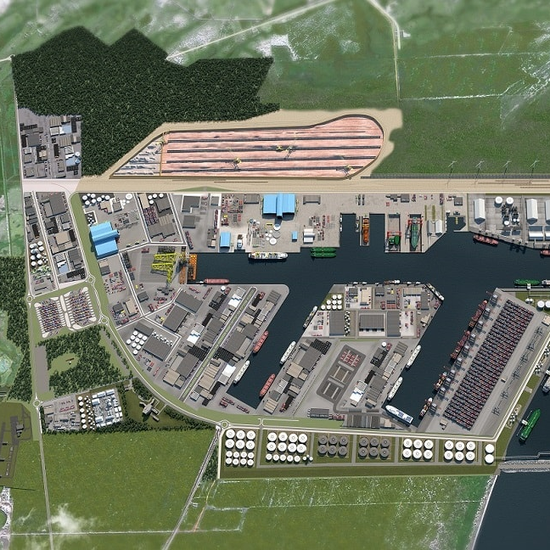
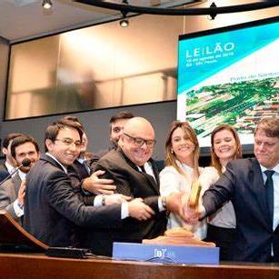
Investment Partnership Program (PPI)
Demand
Design
Decide

Slide 5
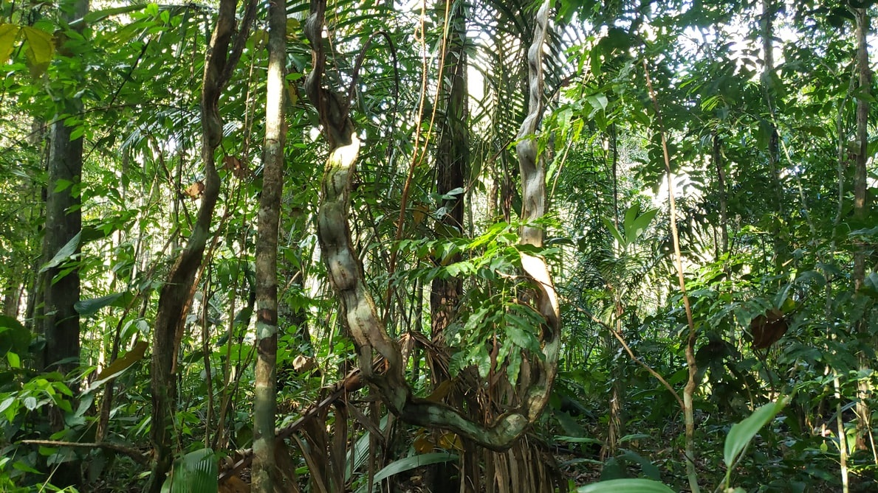
From October to November: 45 projects worth USD 55 billion
100 days for companies to prepare for auction
Transparency: agenda of projects accessible on ppi.gov.br
2022: 124 projects worth USD 65 billions
233 projects already delivered – USD 155 billions in investments
Predictable and non-discriminatory

Slide 6
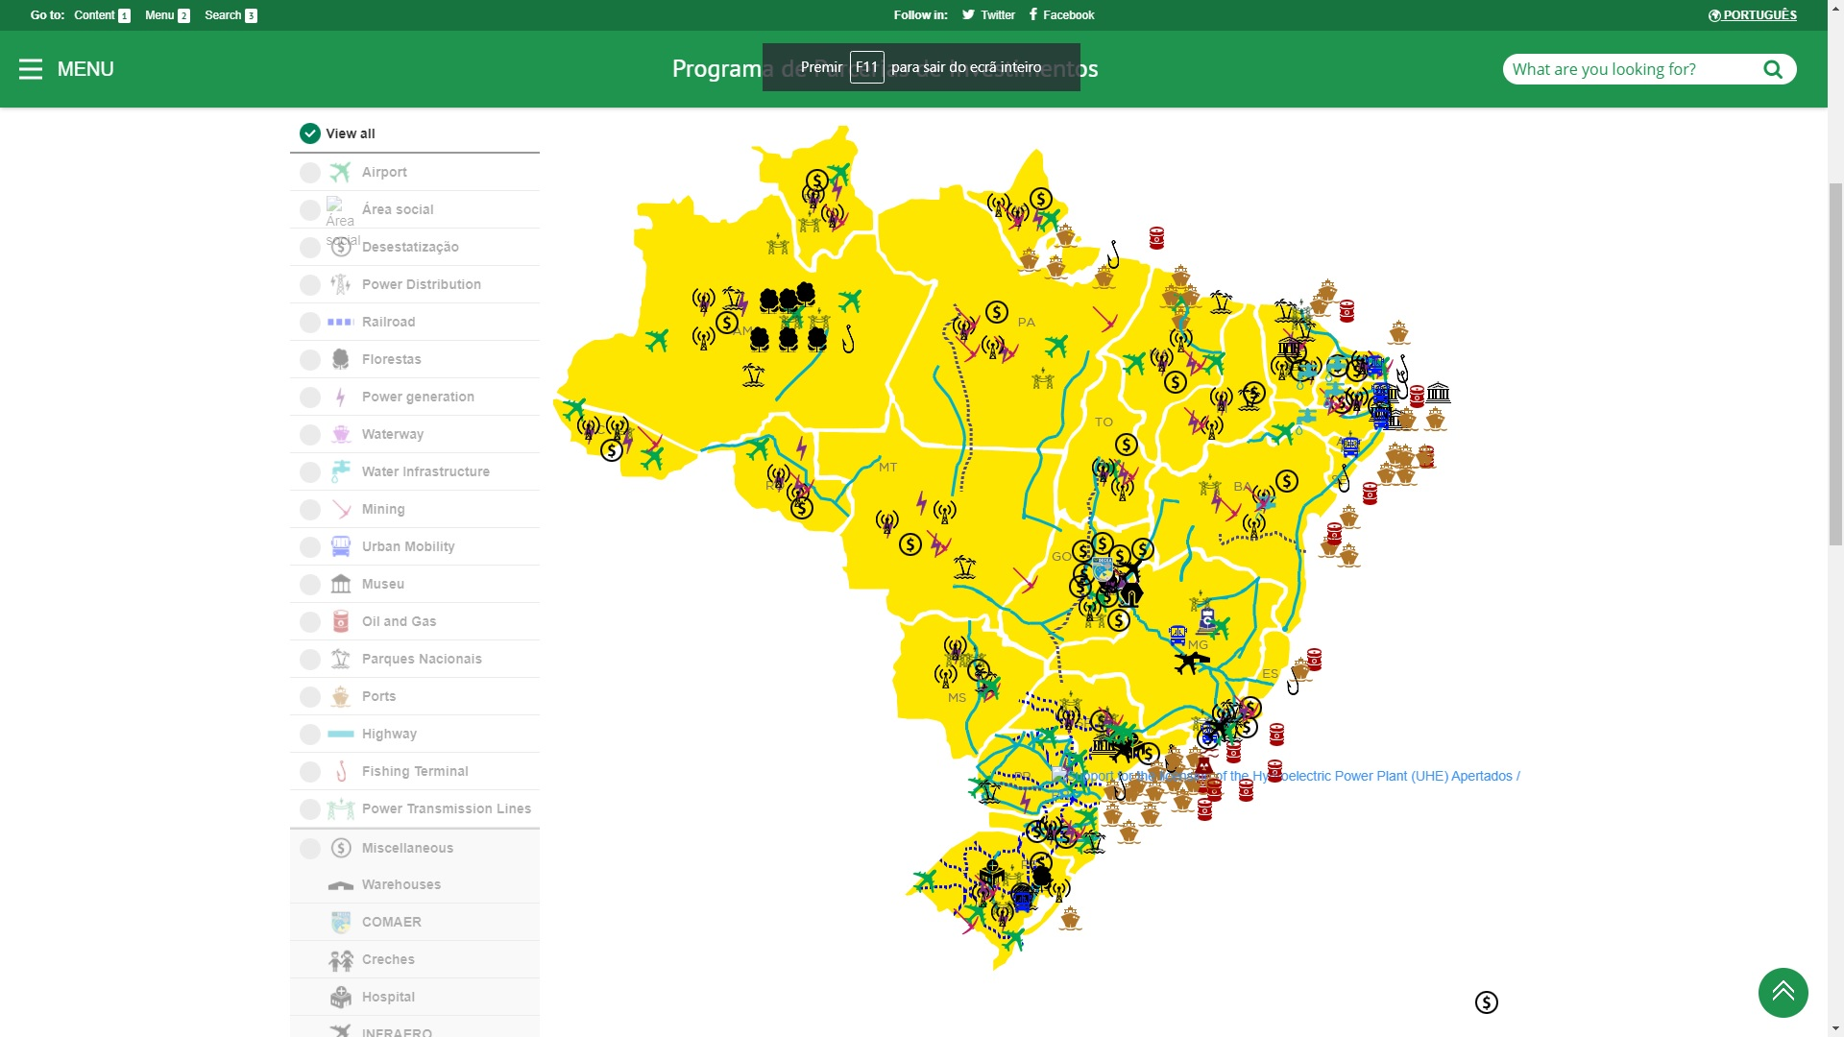

Slide 7
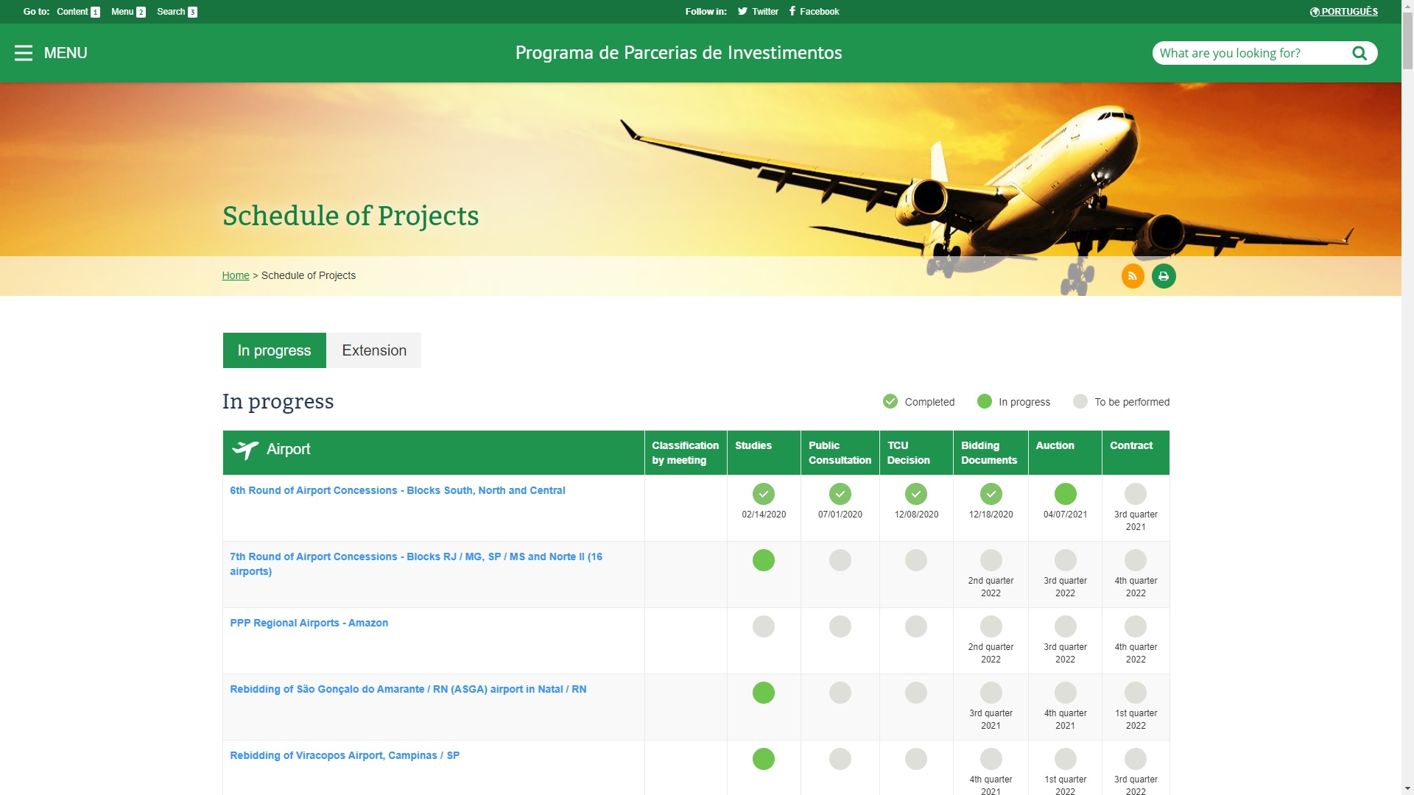

Slide 8





Chinese Investment by Sector (number of projects)
31%
28%
7%
7%
6%
Energy
Manufacturing
Technology
Agriculture
Finance
*Conselho Empresarial Brasil-China

Slide 9
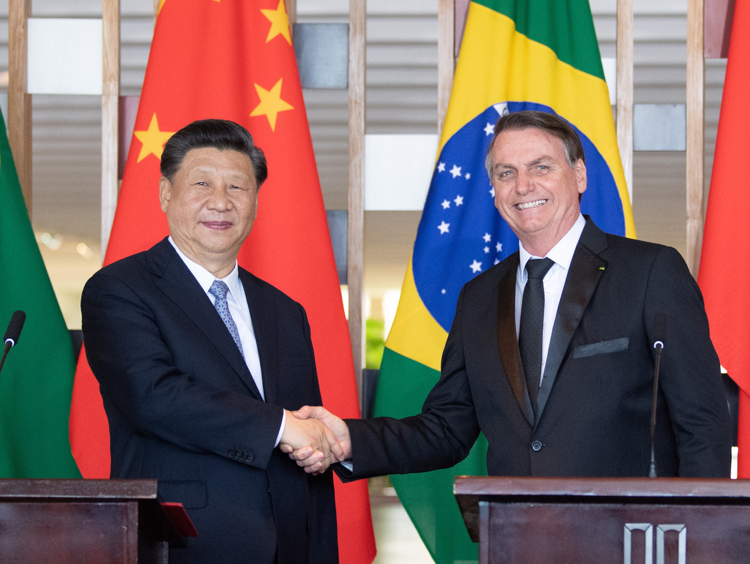
Conclusion
Need for big infrastructure
PPI (Predictable/Transparent/Fair)
Diversified economy
Great chinese presence
Brasil-China is a necessary partnership

Slide 10



Contact Information
Embassy of Brazil
APEX China
Me (李嘉明)

